Slide 1

uNit 4 – Network
Computing Systems

Slide 2
Index
Network systems
Introduction
Types of networks
Classification
OSI Model
TCP/IP vs OSI
Network Acces
IEEE Standards
Transmission media
Transmission techniques
Disturbances
Services and Functions
Internet
IPv4
ARP
Netplan
Routing
Transport
Function, Services and Primitives
Public and Private keys
SSH
Application
SCP and RCP
LZW
DNS
DHCP

Slide 3






Introduction
The target is Share resources!
Data
Computers, Printers, scanner, to sum up devices.
The challenge is connect devices.
Between peers or through the world.
Reliably and Safely.
JavaScript
Request
PHP
Network
Reply
Client
Server

Slide 4
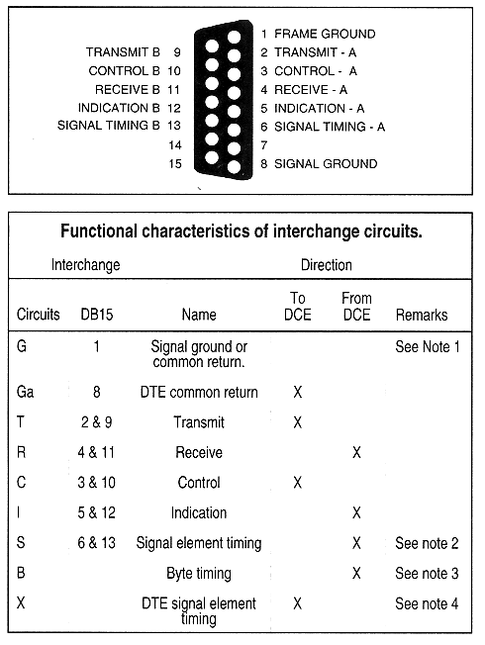
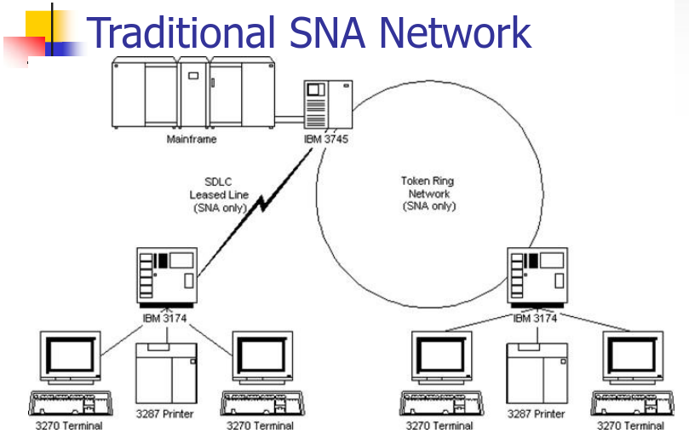

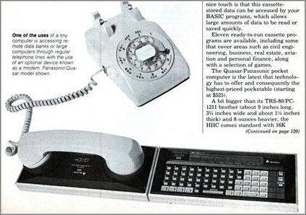
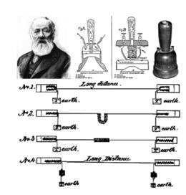
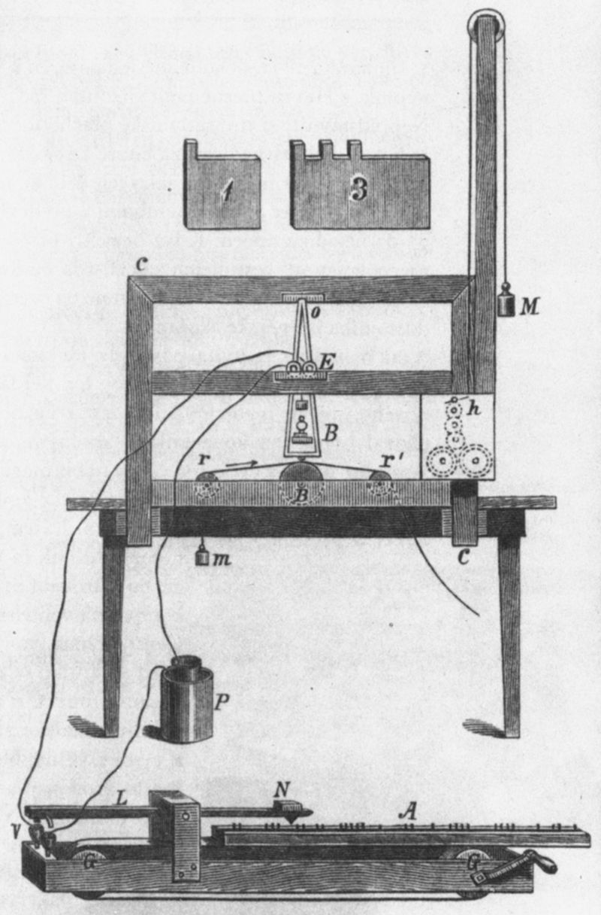

History
TCP/IP
X.21
A sum up
OSI MODEL
Telegraph
Telephone
Modem
Arpanet
IBM SNA
X.21 and X.25
OSI Model
TCP/IP
Font:https://networking.ringofsaturn.com/Protocols/X21.php
Font:https://slideplayer.com/slide/3207708/
Font:https://es.wikipedia.org/
Font:https://www.eurokonzern.es/
Font:https://www.microsiervos.com/
Font:http://iner1.blogspot.com/

Slide 5

OSI basic reference model described in ISO 7498-1 (1984)
Open System Interconnection treat separately:
Bit transmission system
Keep link without error
Routing and congestion control
Connection peer to peer
Improvement services peer to peer and reconnection without error
Compressing data, encryption, manage syntax and semantic
Allow user protocols and processes
Protocols Data unit (PDU) N to N
Application
Application
Presentation
Presentation
Services N to N+1
Session
Session
Transport
Transport
Network
Network
Network
Network
Data Link
Data Link
Data Link
Data Link
Physical
Physical
Physical
Physical
“Divide and Conquer.”
― Julius Caesar

Slide 6
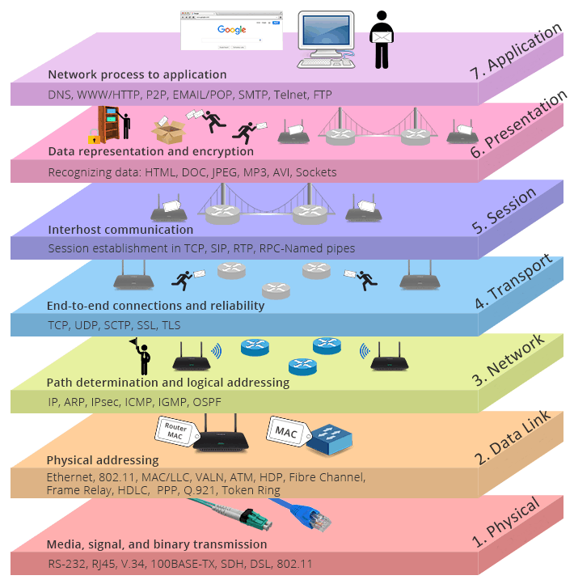
TCP/IP vs OSI
OSI MODEL IS A REFERENCE
APPLICATION
TCP/IP MODEL IS A REAL MODEL!!
TRANSPORT
INTERNET
NETWORK ACCES
Font:https://community.fs.com/

Slide 7




Type of networks
Classification
WAN
According to size:
Body area network BAN
Personal area network PAN
Local area network LAN
Campus area network CAN
Metropolitan area network MAN
Wide area network WAN
MAN
CAN
According to services:
LAN
Server-Client
Peer-to-Peer
PAN
BAN

Slide 8
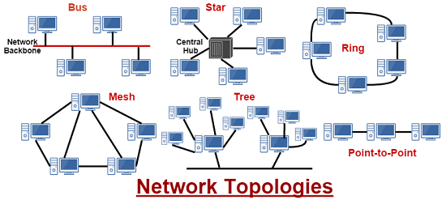
According to topology:
BUS
STAR
RING
MESH
TREE
Font:https://www.assignmenthelp.net/assignment_help/network-topology-and-types

Slide 9
Network Acces
Signals
Sincronus / Asincronus
Digital / Analog
Baseband / Modulated
Serial / Paralel
Physical and Data Link OSI Model
Physical interconnection
Telematics
Type of signals
Electrical parameters
Remote communication techniques
Logical specification
Communication protocols
Detection and error correction
Compatibility
Disturbances
Communications
Simplex
Duplex
SemiDuplex
Transmitter
Channel
Receiver

Slide 10


IEEE STANDARDS
802.2 Logical Link Control LLC
LLC
802
General view
802.11 WLAN
Data Link PDU: Frame
802.1
Management
802.3
CSMA/CD Ethernet
802.4
Token Bus
802.5
Token Ring
802.6
Optical FIber
802.15
Bluetooth
802.16
Wimax
MEDIA ACCES CONTROL
802.11
IR
802.11
FHSS
.11a
OFDM
.11b
DSS
.11g
DSS
OFDM
Physical PDU: Bit
SONET
SDH
Services:
Modulation
Synchronisation
Init and end
Multiplexing
Carrier Detection
Filtering and Equalization
Functions:
Peer to Peer / Multicast
Duplex/Semi Duplex/Simplex
Electronics /Optical/Mechanical
Topology
Serial / Paralel
Physical example protocol
Telephone Network
DB25
DB25
RS-232
(Recommended Standard 232)
Modem
DTE
Data terminal Equipment
DCE
Data Circuitering Equipment

Slide 11
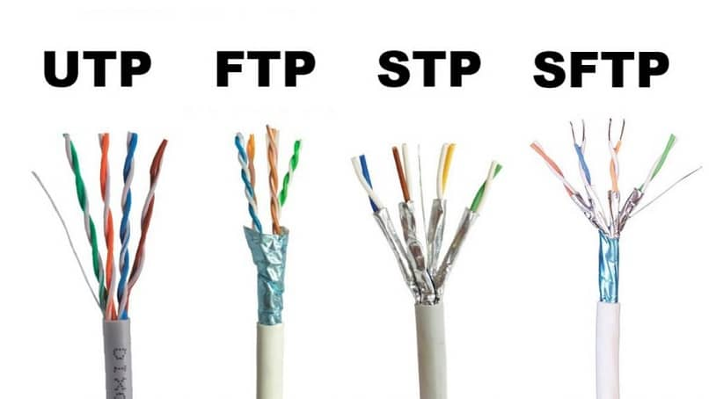
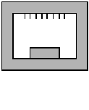
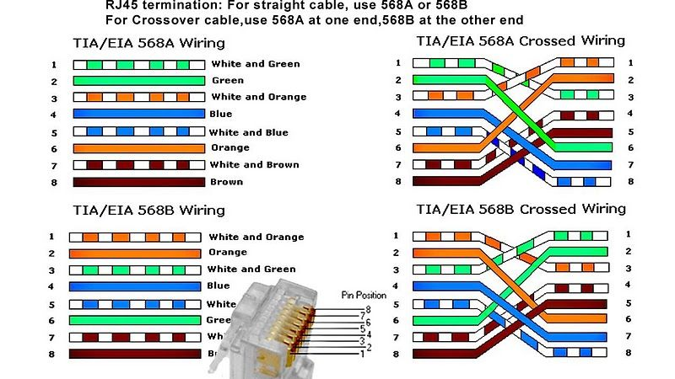
P3
Transmission media
P2
P1
P4
Guided
Twisted pair (Unshielded UTP or Shielded STP)
Coaxial 50Ω or 75Ω
Optical Fiber
Not guided
Microwave
Infrared
Others (LIFI, HF etc)
1 2 3 4 5 6 7 8
Font:https://miracomosehace.com/
RJ-45
Cat 5 100Mbps Carry 100MHz
Cat 5e 1Gbps Carry 100MHz
Cat 6 1Gbps Carry 250MHz +Performance
Cat 7 10Gbps Carry 600MHz +Shield
Font:https://www.pinterest.es
Cat 8 25Gbps Carry 2000MHz

Slide 12
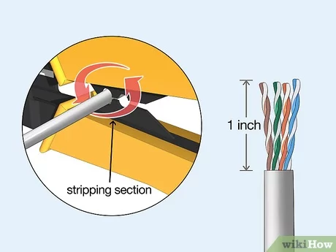
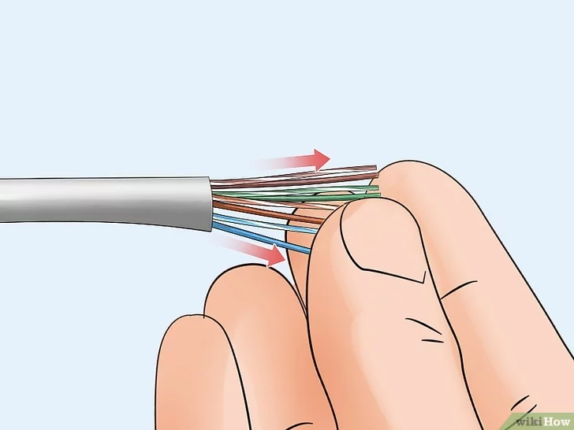
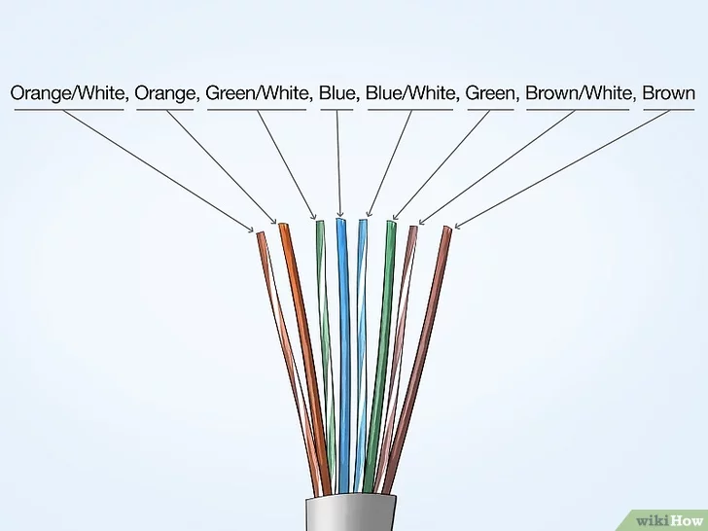
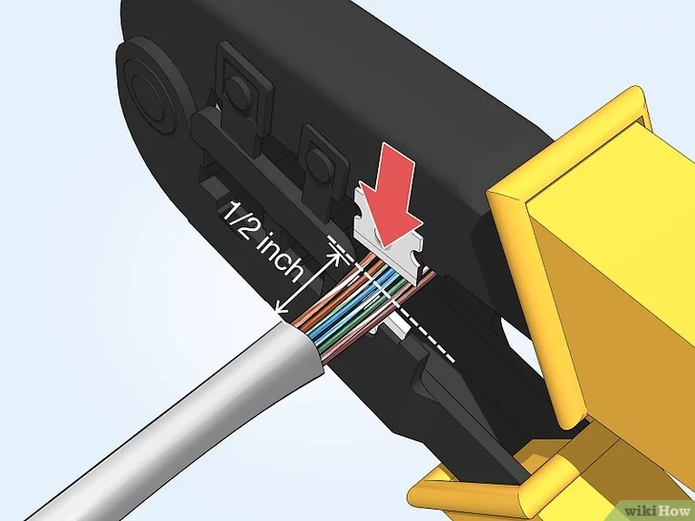
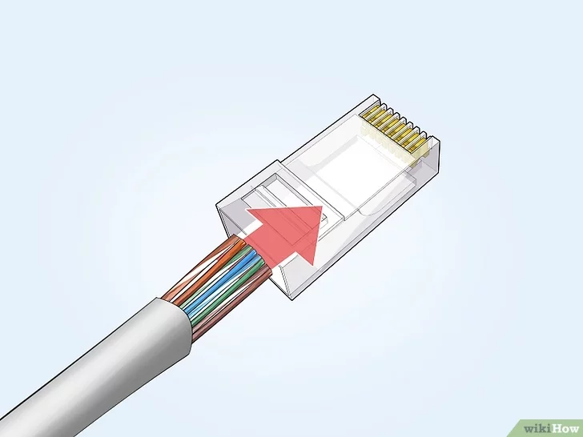
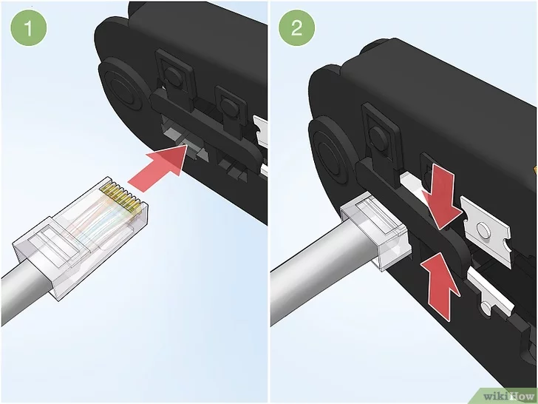
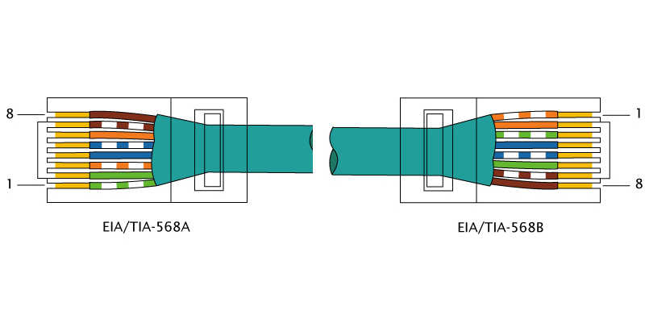
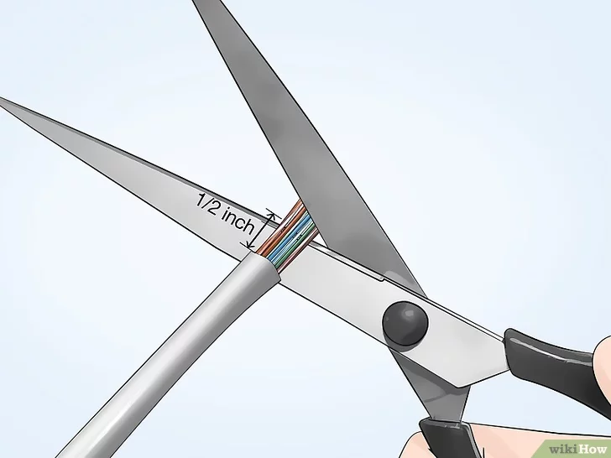
Font:https://es.wikihow.com/crimpar-una-clavija-RJ-45 and https://www.helicateringservices.com

Slide 13
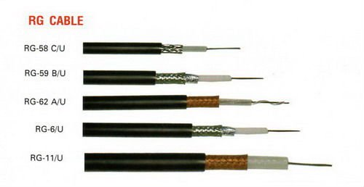
Transmission media
Guided
Twisted pair (Unshielded UTP or Shielded STP)
Coaxial 50Ω or 75Ω(TV)
Optical Fiber
Not guided
Microwave
Infrared
Others (LIFI, HF etc)
Bell Labs wave machine
COAXIAL Bandwidth 500MHz
10-Base 5 | RG-8,RG-9,RG-11 10Mbps 500m
10-Base 2 | RG-58A/U 10Mbps 200m
Font:https://miracomosehace.com/

Slide 14
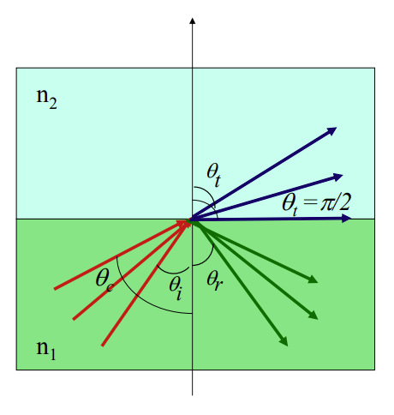
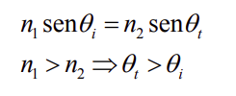
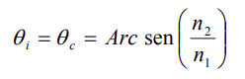
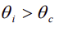
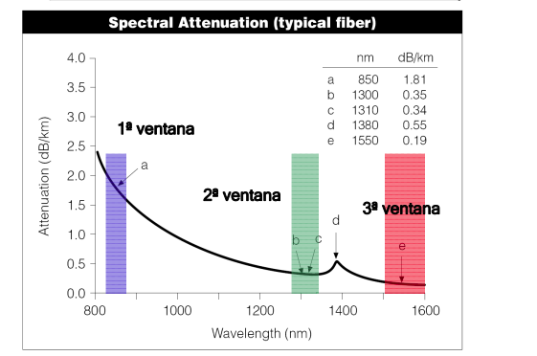
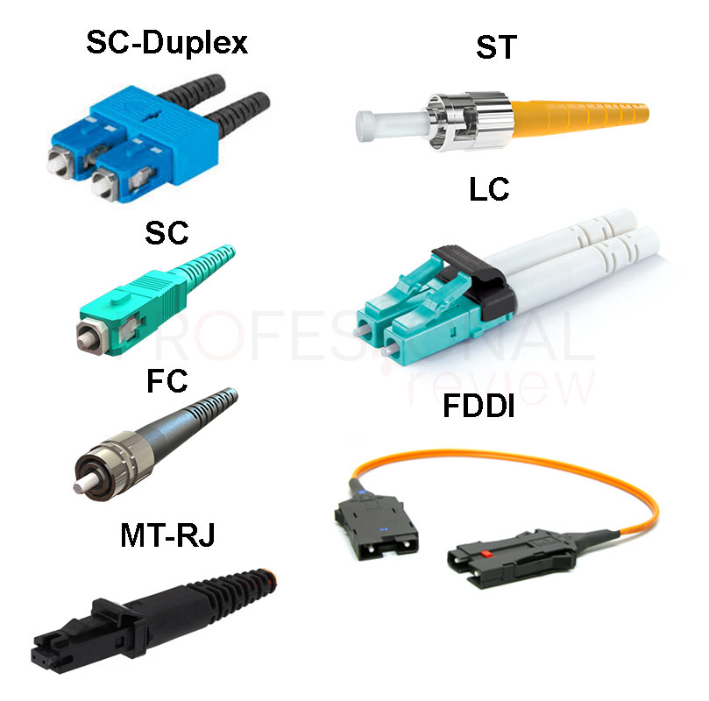
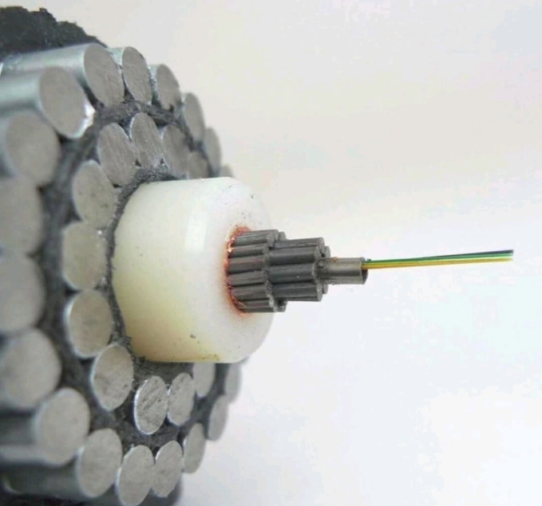
Snell’s law
Transmission media
Guided
Twisted pair (Unshielded UTP or Shielded STP)
Coaxial 50Ω or 75Ω(TV)
Optical Fiber
Multimode
Monomode
Not guided
Microwave
Infrared
Others (LIFI, HF etc)
Coating
Cladding
(n2)
If
All signal are reflected
Core (n1)
Font:https://www.profesionalreview.com/redes/

Slide 15
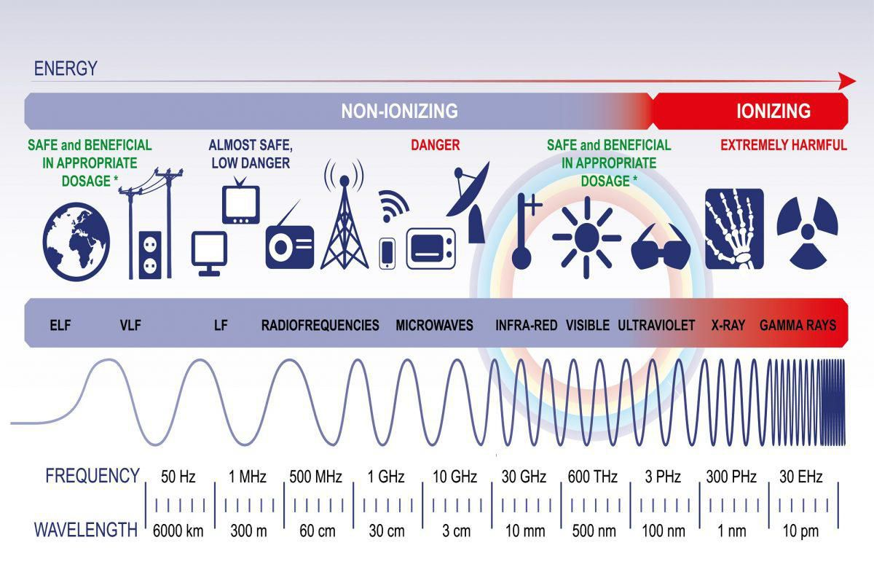
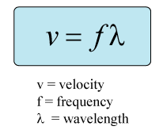
Transmission media
Guided
Twisted pair (Unshielded UTP or Shielded STP)
Coaxial 50Ω or 75Ω(TV)
Optical Fiber
Not guided
Microwave
Right of way allowed
Poor performance with obstacles
Authorization required
Infrared
Others (LIFI, HF etc)
Font:https://www.forbes.com/
>1GHz travel straight

Slide 16
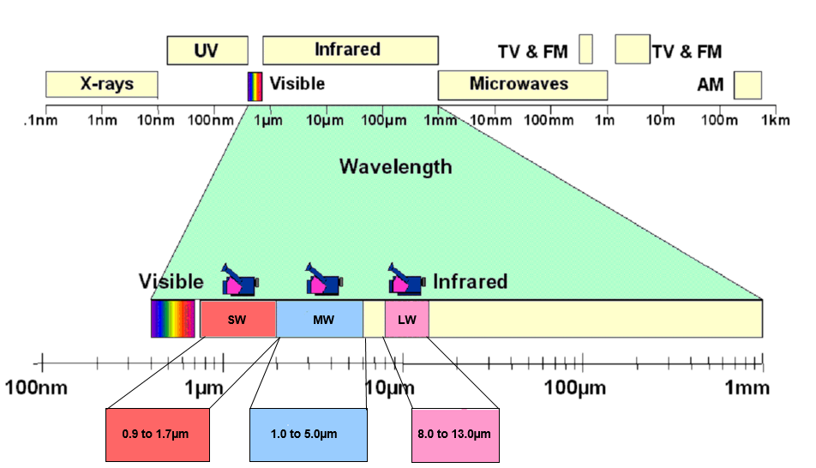

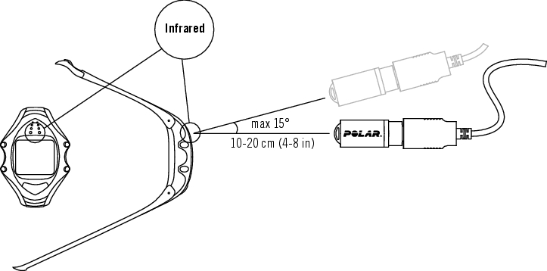
Transmission media
Guided
Twisted pair (Unshielded UTP or Shielded STP)
Coaxial 50Ω or 75Ω(TV)
Optical Fiber
Not guided
Microwave
Infrared
Others (LIFI, HF, etc)
Font:https://movitherm.com/knowledgebase/thermal-infrared-imaging-explained/
Font:https://support.polar.com/
Font:https://mandoadistanciaparatv.com/

Slide 17
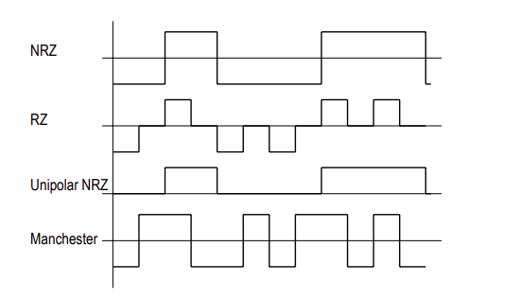
Transmission techniques
Base Band
Modulated Band
Digital Modulations
Multiple access

Slide 18
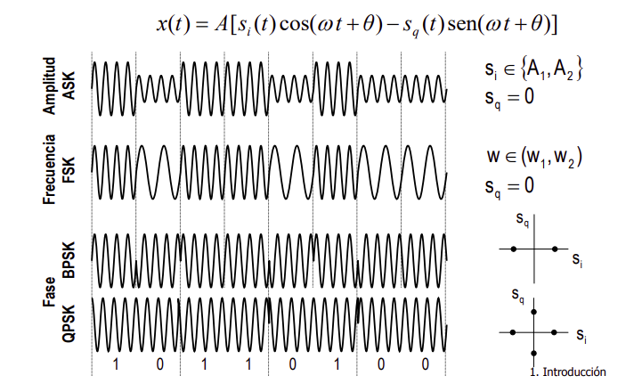
Transmission techniques
Base Band
Modulated Band
Digital Modulations
Multiple access

Slide 19
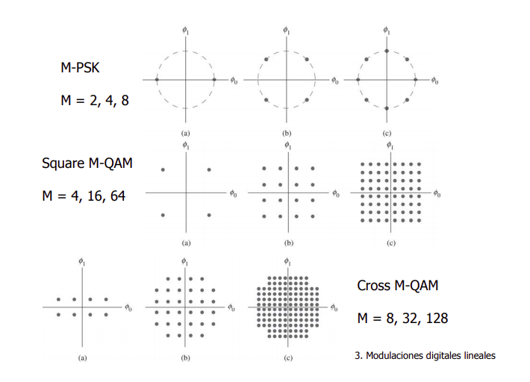
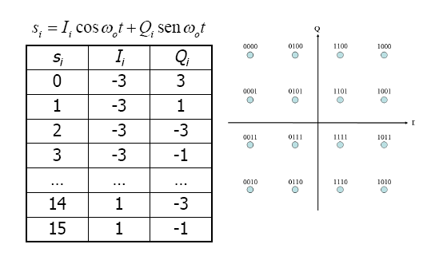
Transmission techniques
Base Band
Modulated Band
Digital Modulations
Multiple access
People from other class who don't known Complex numbers

Slide 20
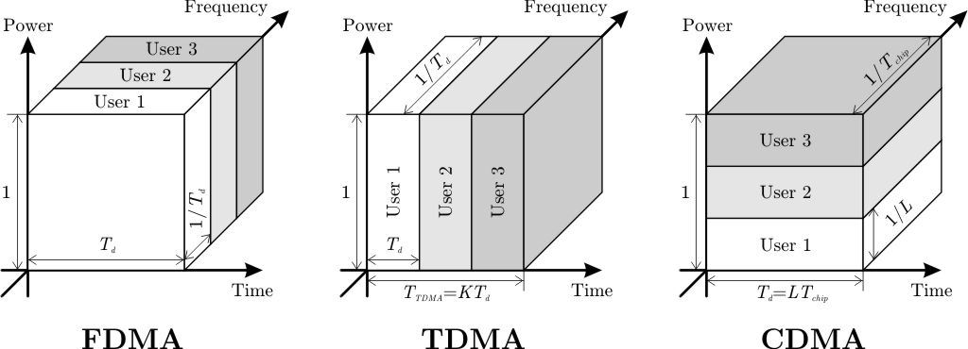
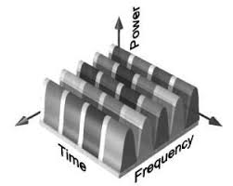
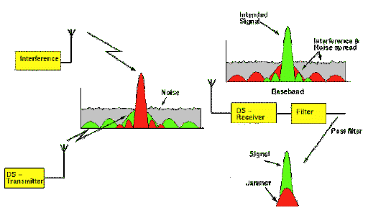
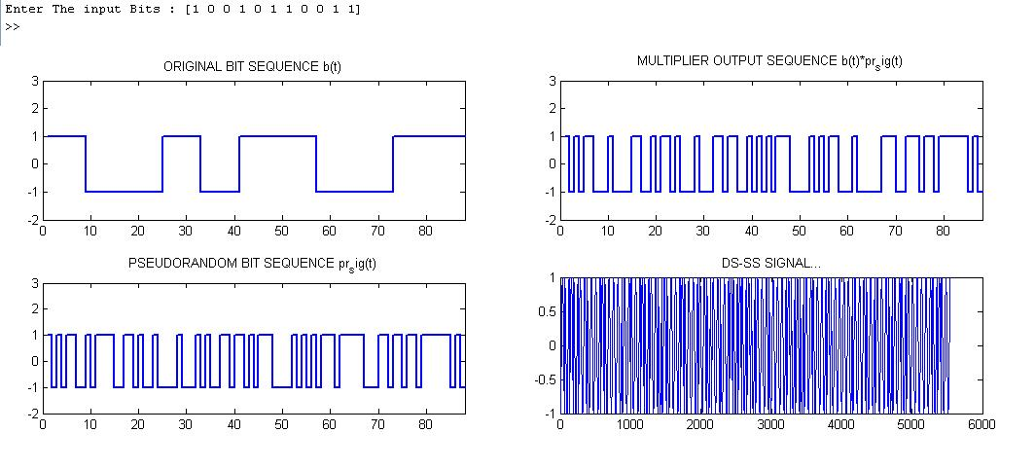
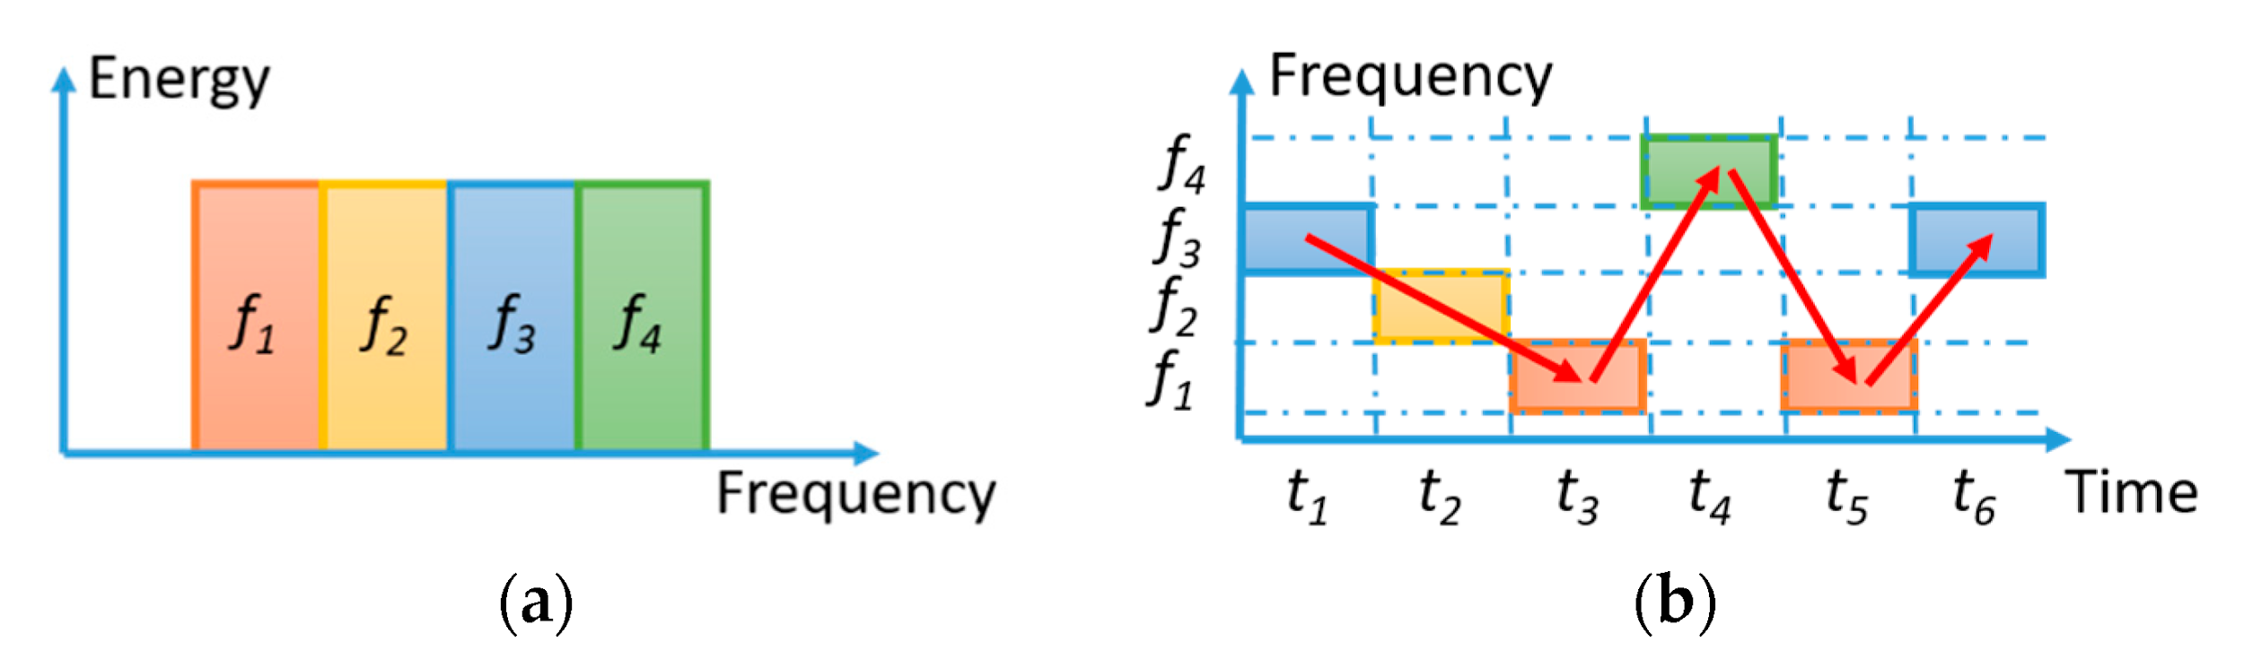
Transmission techniques
Base Band
Modulated Band
Digital Modulations
Multiple access
Time Division Multiple Access TDMA
Frequency Division Multiple Access
Code Division Multiple Acces
TDMA/FDMA
Spread Spectrum Multiple Access SSMA
Direct Sequence Spread Spectrum DSSS
Frequency Hopping FHSS

Slide 21
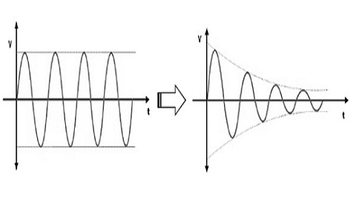
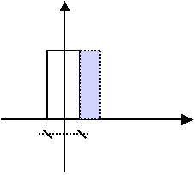
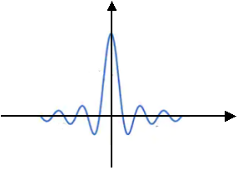
A (dB) = 10 log10 (PotT/PotR)
Where
A = Attenuation
PotT = Power Transmitted
PotR = Power Received
Disturbances
Atenuattion
Distortion phase or frequency
Noise
Thermal (Electronics components)
Intermodulation (Other frequencies)
Crosstalk
Impulsive (Spikes)
Echoes(multipath)
AΠ(t/T)
ATsinc(fT)
Echo
Other sinc in each zero is OFDM principle
t
f
T
1/T , 2/T , 3/T ...
Nyquist f>=2B
Shannon
x0·Π(t/T)
x1·Π(t/T)· e^(j2Πt1/T)
...
xn·Π(t/T) · e^(j2ΠtN/T)
C = 2B log2 M
Where
C = Capacity of the channel
B = Bandwidth
M = Number of discrete signal or voltage level
S = Signal
N = Noise
C = B log2(1+S/N) bps
Font:https://en.wikipedia.org/wiki/Shannon%E2%80%93Hartley_theorem

Slide 22
IEEE STANDARDS
802.2 Logical Link Control LLC
LLC
802
General view
802.11 WLAN
Data Link PDU: Frame
802.1
Management
802.3
CSMA/CD Ethernet
802.4
Token Bus
802.5
Token Ring
802.6
Optical FIber
802.15
Bluetooth
802.16
Wimax
MEDIA ACCES CONTROL
802.11
IR
802.11
FHSS
.11a
OFDM
.11b
DSS
.11g
DSS
OFDM
Physical PDU: Bit
SONET
SDH
Services:
Framework
Error control
Connection Oriented
Flow control
Offline services
Not Flow control
Functions:
Error detection and correction
Fragmentation and defragmentation
Media access control
Yes
Transmission
Receiver
n’ bits
Paritty
Generator
(k’’ bits)
k’’ bits
k’’==k’
n bits
n+k bits
No, Error!
Paritty
Generator
(k bits)
Splitter
k’ bits

Slide 23
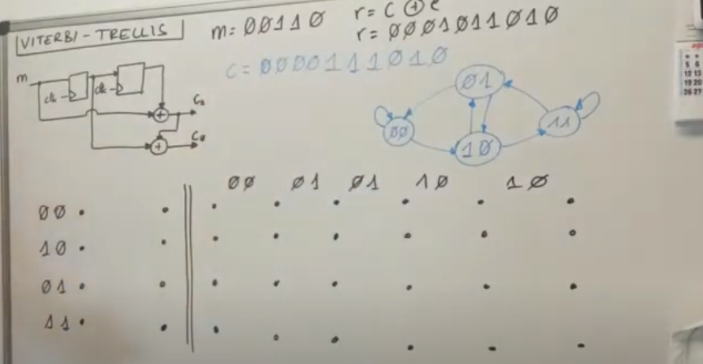
Viterbi Algorithm
Redundancy generator
R1
R0
m
01
0
1
0
1
00
0
1
11
clk
c1
1
10
1
m=00110
c= 00 00 11 10 10
c0
r= c+Error
Generator
Reception with error
r= 00 01 01 10 10
R1 R0
00
01
01
10
10
00
10
01
11
*
*
*
*
0/00
*
*
*
*
*
*
*
*
0
1
*
*
*
*
*
*
*
*
*
*
*
*
*
*
*
*
*
*
*
*
1/11
2
1
0/01
2
 |  | Hamming distance
00 | 11 | 2
01 | 11 | 1
11 | 01 | 1
1/10
4
Path with less cost (Hamming distance) give us the correct code
if m=1 c=11 then 1/11
0/00 0/00 1/ 1/ 0/

Slide 24
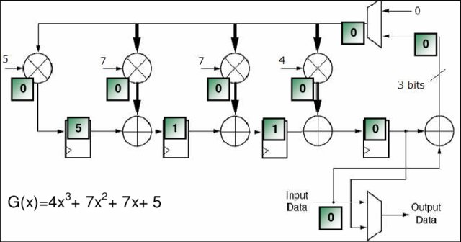
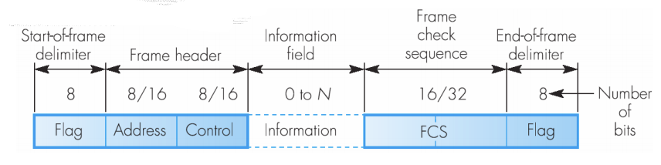
HDLC (High-level Data Link Control):
Connection Oriented
Establishing the link connection
Data transmission
Termination of the link connection
Ensures reliable delivery of frames
Transmission errors are detected and bad frames are discarded
All lost or erroneous frames are retransmitted
All duplicate frames are detected and discarded
Frames are delivered to the top layer neat and error free
The flow control is performed between the emitter and the receiver
To carry out error handling:
Error detection techniques
Frame numbering
Confirmation of all frames received correctly
Retransmission unconfirmed frames
Use
Cisco devices
Networks with high error rates.
01111110

Slide 25
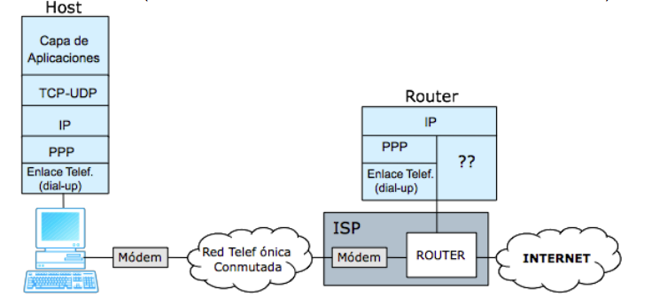
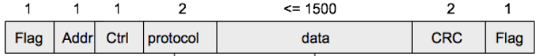
PPP (Point to point) and LLC (Logic Link Control) protocol:
Offline services
Not guarantee reliable delivery of frames
Transmission errors are detected and bad frames are discarded
Missing or erroneous frames are not retransmitted
Correct frames are not confirmed
Possible duplicate frames are not detected or discarded
Frames are delivered to the top layer in the order they arrive
No flow control between emitter and receiver
No establishment or connection end phases
Each frame is considered independent of the rest
Use
Networks with low error rates (these are the most common today)
ADSL (PPPoE = PPP over Ethernet, PPPoA = PPP over ATM)
MAC Address

Slide 26
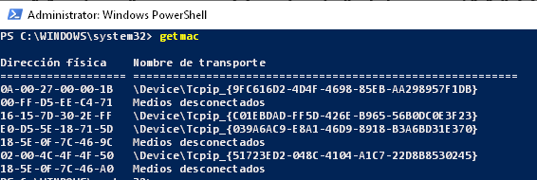
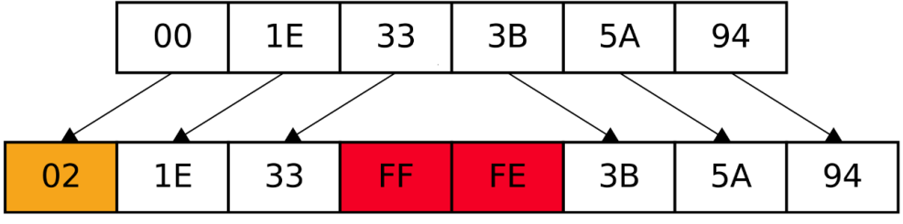
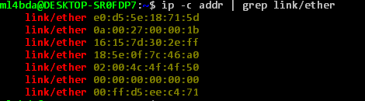




Media Access Control Address (MAC Address)
MAC-48 deprecated
EUI-48 2^48 (281.474.976.710.656)
EUI-64 add 16 bits more (RFC 2464)

Slide 27


Internet
Network OSI Model PDU:Packet or Datagram
Addressing
IP addressing Classless Inter-Domain Routing (CIDR)
All components has IP address
Identify Network and Host
IPv4 RFC791
IPV6
Routing
All component is routed to destination using tables and rules.

Slide 28

IPv4
32 to be grouped in eights
RFC5735 Classes and reserved addresses
A mask is used to known Network or Host bits
Some are Private IPs RFC1918:
Class A
10.0.0.0 to 10.255.255.255
Class B
172.16.0.0 to 172.31.255.255
Class C
192.168.0.0 to 192.168.255.255
Loopback RFC1122:
127.0.0.0 to 127.255.255.255
Link-Local RFC3927:
169.254.1.0 to 169.254.254.255
Multicast RFC1122:
224.0.0.0 to 224.0.0.15
Future RFC1122:
240.0.0.0 to 240.0.0.15
Broadcast RFC919:
255.255.255.255/32
Class A
0.0.0.0 to 127.255.255.255 Mask 255.0.0.0
Class B
128.0.0.0 to 191.255.255.255 Mask 255.255.0.0
Class C
192.0.0.0 to 223.255.255.255 Mask 255.255.255.0
Class D
224.0.0.0 to 239.255.255.255
Class E
240.0.0.0 to 255.255.255.255

Slide 29



Classe | Extended mask | Reduced mask | Binary mask | Wildmask
A | 255.0.0.0 | /8 | 11111111.00000000.00000000.00000000 | 0.255.255.255
B | 255.255.0.0 | /16 | 11111111.11111111.00000000.00000000 | 0.0.255.255
C | 255.255.255.0 | /24 | 11111111.11111111.11111111.00000000 | 0.0.0.255
Net Address | Mask | First Host Address | Last Host Address | Broadcast Address | Nº Hosts
147.23.0.0 | 255.255.0.0 | 147.23.0.1 | 147.23.255.254 | 147.23.255.255 | 2^16 – 2 = 65534

Slide 30




IPv4 Datagram
192.168.1.109/24
192.168.1.1/24
ping 192.168.1.1
Wireshark

Slide 31



Address Resolution Protocol (ARP) RFC 826 and RFC 5227 / 5494.
I’m ready to sent to print for first time!. -The printer’s IP = 192.168.0.29 -
Host: Hey there (sending to FF:FF:FF:FF:FF:FF) Who has ? 192.168.0.29
Printer: to host...Hey! 192.168.0.29 is at 14:2d:27:bc:46:4d
Ok noted! Now I can send data to print to 14:2d:27:bc:46:4d

Slide 32





NetworkManager
systemctl stop network-manager
systemctl start network-manager
systemctl disable network-manager
systemctl enable network-manager
systemctl mask network-manager
systemctl unmask network-manager
Is possible to return to the classical notation adding a line to /etc/default/grub and rebuild it

Slide 33



Network Manager has nmcli to management
$ nmcli con add con-name eth1 type wifi ifname eth1 ipv4.method auto
$ nmcli con mod eth1 ipv6.method ignore
$ nmcli con edit
$ nmcli con reload
# nmcli radio
# nmcli device wifi rescan
# nmcli device wifi list
# nmcli device wifi connect SSID-Name password wireless-password

Slide 34




Dijkstra algorithm for dynamic routing
3
STEP | NODES
 | A | B | C | D
0 | 0 | inf/- | inf/C | inf/-
1 | - | 7/A | 3/A | inf/-
2 | - | 5/C | - | 11/C
3 | - | - | - | 7/B
A
C
7
2
8
B
2
D

Slide 35
Transport
Transport OSI Model PDU:Segment or Datagram
Functions
Services
Fragmentation / Defragmentation
Multiplexing / Demultiplexing
Flow Control
Error Control
Connection Oriented (TCP)
Establishment
Transferring
Release connection
Connectionless Communication (UDP)
Host A
Host B
Host A
Host B
Primitives
SYN (seq= x)
SYN (seq= x)
SYN (seq= y)
Only one connection results
LISTEN
CONNECT
SEND
RECEIVE
DISCONNECT
SYN (seq= y, ACK=x+1)
SYN (seq= y, ACK=x+1)
SYN (seq= x+1, ACK= y+1)
SYN (seq= x, ACK= y+1)
time
time

Slide 36





SSH (Secure Shell)
$ sudo systemctl start ssh
$ sudo nano /etc/ssh/sshd_config
$ sudo systemctl reload ssh
Provides a secure channel over an unsecured network
Use public and private key i useful to scripting
ssh -X <user_name>@<ip_addres> -p <port>
Get-Service sshd
Start-Service sshd
Stop-Service sshd
type $env:USERPROFILE\.ssh\id_rsa.pub | ssh pi@IP_ADDRESS "cat >> .ssh/authorized_keys"
scp .ssh/id_rsa.pub teacher@IP_ADDRESS:"C:\ProgramData\ssh\administrators_authorized_keys"
cssh netadmin@192.168.1.{1..254}
120

Slide 37

Application
Session OSI Model PDU: Transaction or Datagram
Functions
Services
Access point to services
Establishment
Release connection
SCP Secure copy
Authentication less (SSH do it)
Encrypted data
RCP Remote copy files
rcp [-r] source-file|directory target-file|directory

Slide 38


Application
Presentation OSI Model PDU: Datagram
Functions
Data format
Encryption
Compression
MP3, JPEG, AVI, Lemple-Ziv-Welch(LZW)

Slide 39
LZW
TOBEORNOTTOBEORTOBEORNOT #
# | A | B | C | D | E | F | G | H | I | J | K | L | M | N | O | P | Q | R | S | T | U | V | W | X | Y | Z
0 | 1 | 2 | 3 | 4 | 5 | 6 | 7 | 8 | 9 | 10 | 11 | 12 | 13 | 14 | 15 | 16 | 17 | 18 | 19 | 20 | 21 | 22 | 23 | 24 | 25 | 26 | 27
TEXT | CODE
TO | 28
OB | 29
BE | 30
E0 | 31
OR | 32
RN | 33
NO | 34
OT | 35
TT | 36
TOB | 37
BEO | 38
ORT | 39
TOBE | 40
RNO | 42
OT # | 43
TEXT | CODE
T | 20
O | 15
B | 2
E | 5
O | 15
R | 18
N | 14
O | 15
T | 20
TO | 28
BE | 30
TEXT | CODE
OR | 32
TOB | 37
EO | 31
RN | 33
OT | 35
# | 0
40/15/33/35/37/41/37/41/33/43 there are 10 codes Log2(43)≈5,426 thus 60 bits
Alphabet has 27 letters Log2(27)≈ 4,75 thus 135 bits
Arround 50% Compression !!

Slide 40


Application
Application OSI Model PDU: Datagram
Functions
Applications and interfaces
Show human readable
Telnet, FTP, DNS, SMTP

Slide 41


Dynamic Host Configuration Protocol (DHCP)
Under UDP
Client sent DHCP Discovery to broadcast and port 67, from IP 0.0.0.0 and port 68
Server sent DHCP Offer to broadcast
IP: source=192.168.1.1; destination=255.255.255.255
UDP: source port=67; destination port=68
sudo dhclient -r

Slide 42
To finish....
Thanks!

